Slide 1
TEAM 101
Saif Ali
Othiraja
Jai Sachin
Adithya kumar

Slide 2
PROBLEM STATEMENT
The Dataset includes employee information about their mode of transport as well as their personal and professional details like age, salary, work exp. We need to predict whether or not an employee will use Car as a mode of transport. Also, which variables are a significant predictor behind this decision?

Slide 3

What is EDA?
EDA stands for “Exploratory Data Analysis.” It is an important initial step in the data analysis process, where data analysts and data scientists examine and summarize key characteristics of a dataset. The primary goals of EDA are to understand the data, discover patterns, identify anomalies, and generate hypotheses for further analysis.

Slide 4
ML MODEL
Logistic Regression is a statistical model used for binary classification tasks, predicting the probability of an event occurring or not occurring. It uses the sigmoid function to model this relationship, with coefficients representing the impact of input features on the event's likelihood. Logistic Regression is interpretable, widely used for binary classification, and can be extended for multiclass problems. Regularization techniques can prevent overfitting, making it a valuable tool in various fields for its simplicity and interpretability

Slide 5
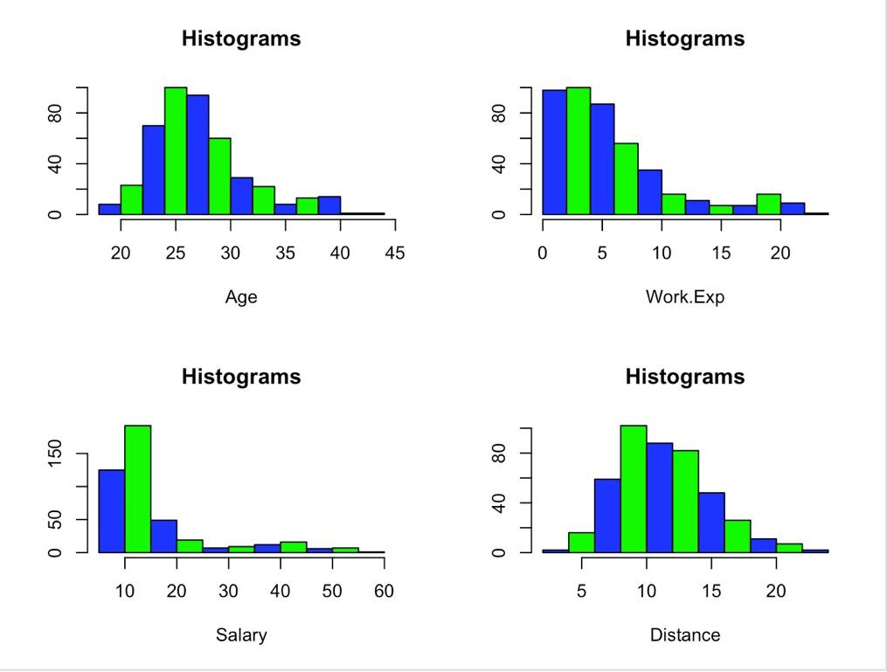
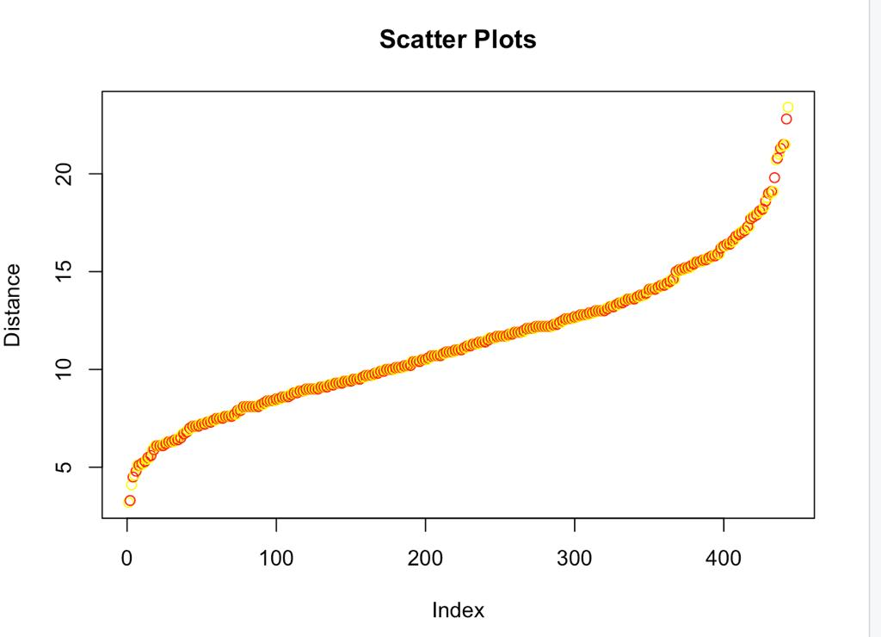
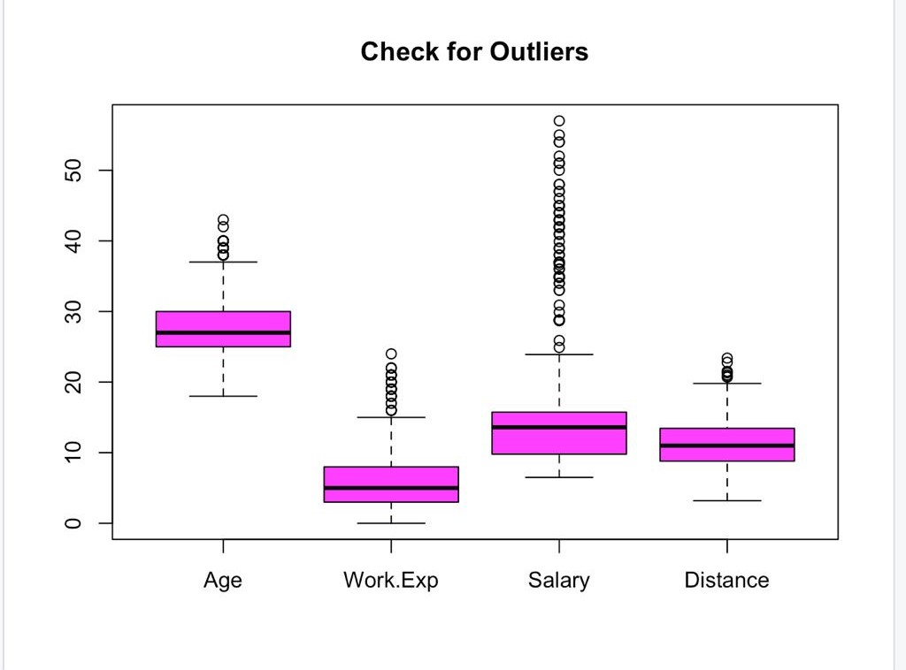
OUR ML MODEL RESULTS

Slide 6
OUR ML MODEL RESULTS

Slide 7
OUR ML MODEL RESULTS

Slide 8
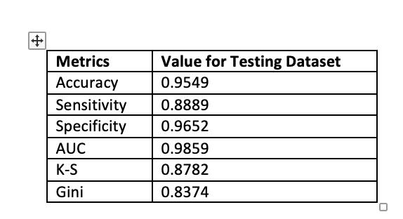
METRICS & VARIABLES USED

Slide 9
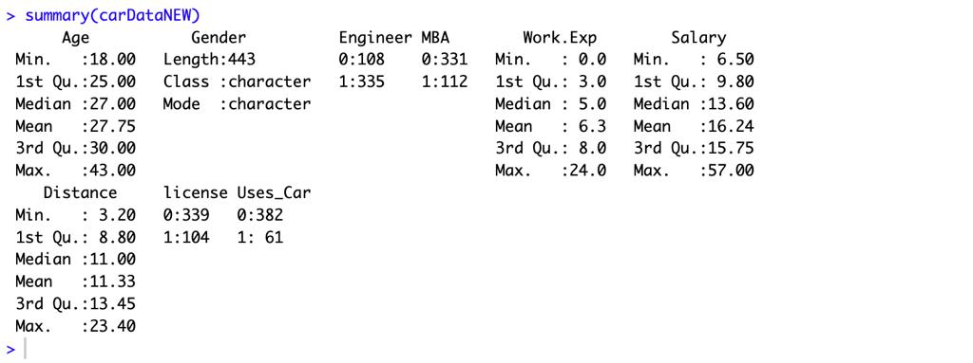
METRICS & VARIABLES USED

Slide 10
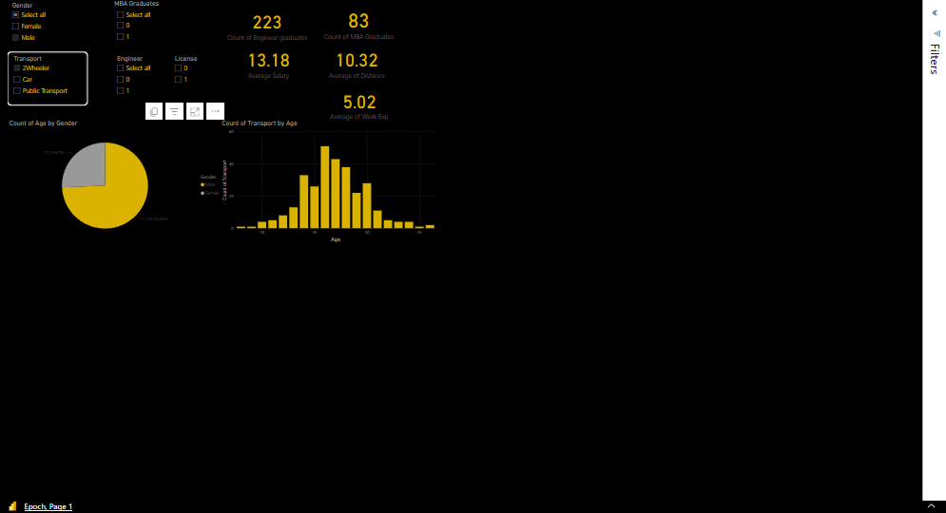

Slide 11
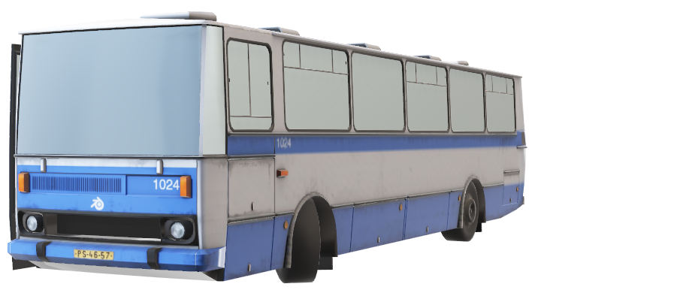
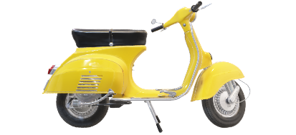

ACCURACY – 95.49%
OUR INSIGHTS
52.2%

Slide 12
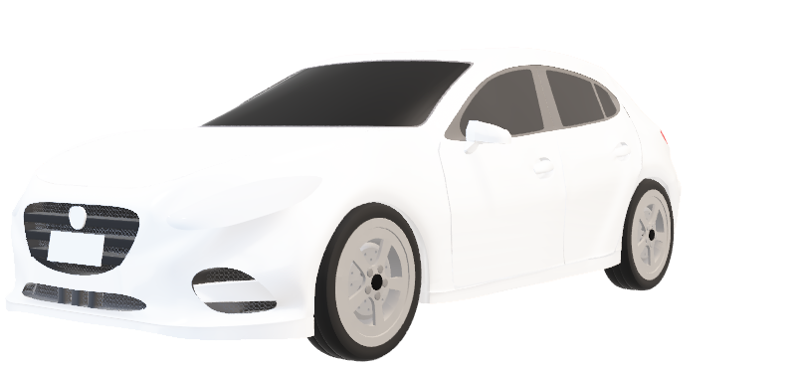

ACCURACY – 95.49%
OUR INSIGHTS
5.6%

Slide 13
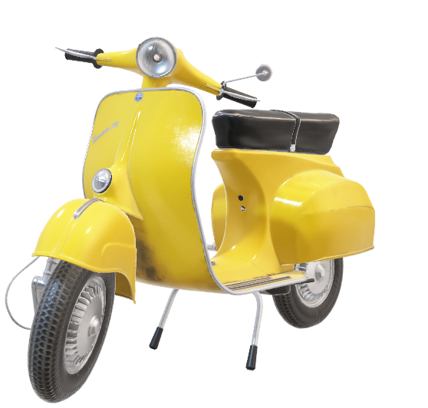
ACCURACY – 95.49%
OUR INSIGHTS
13.5%

Slide 14
Thus
Logistic
Regression
model is suggested

Slide 15
THANK YOU

